Slide 1
ELUCIDATING DRUG-DRUG INTERACTIONS UNDERLYING DRUG POLYPHARMACY PROFILES
UNIVERSITY OF COPENHAGEN
FACULTY OF HEALTH AND MEDICAL SCIENCES

Slide 2
Project description
First phase -> recollect DDIs information from public databases.
Treat and tidy data -> Linkage network between features
Integrate drugs and DDIs merging datasets.
Stablish a dataset that relates all identifiers.
Databases
Pharmacovigilance (Drugbank, KEGG, TWOSIDES)
Clinically-oriented data (NDF-RT)
NLP corpora (DDI corpus 2013)

Slide 3
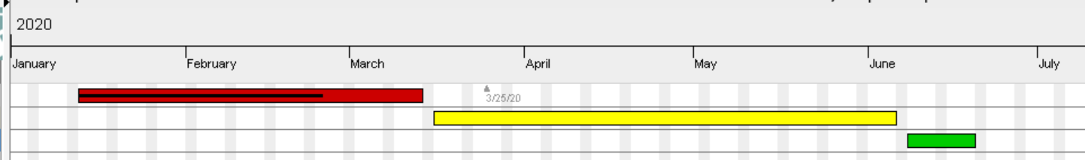
TIMELINE
Reading papers
Extracting and tidying data.
Phase 1; Collecting resources
Phase 2; Computational analysis
Phase 3; TFG

Slide 4
UNTIL NOW…
GitHub project to store data extracted, code generated, issues…
Mostly R scripts.
Significant use as a data source of GitHub project “public-PDDI-analysis”.
Source of the databases selected
Drugbank -> Drugbank website
KEGG -> KEGG REST API
NDF-RT -> public-PDDI-analysis
TWOSIDES -> Tattoneti lab
DDI Corpus 2013 -> public-PDDI-analysis

Slide 5
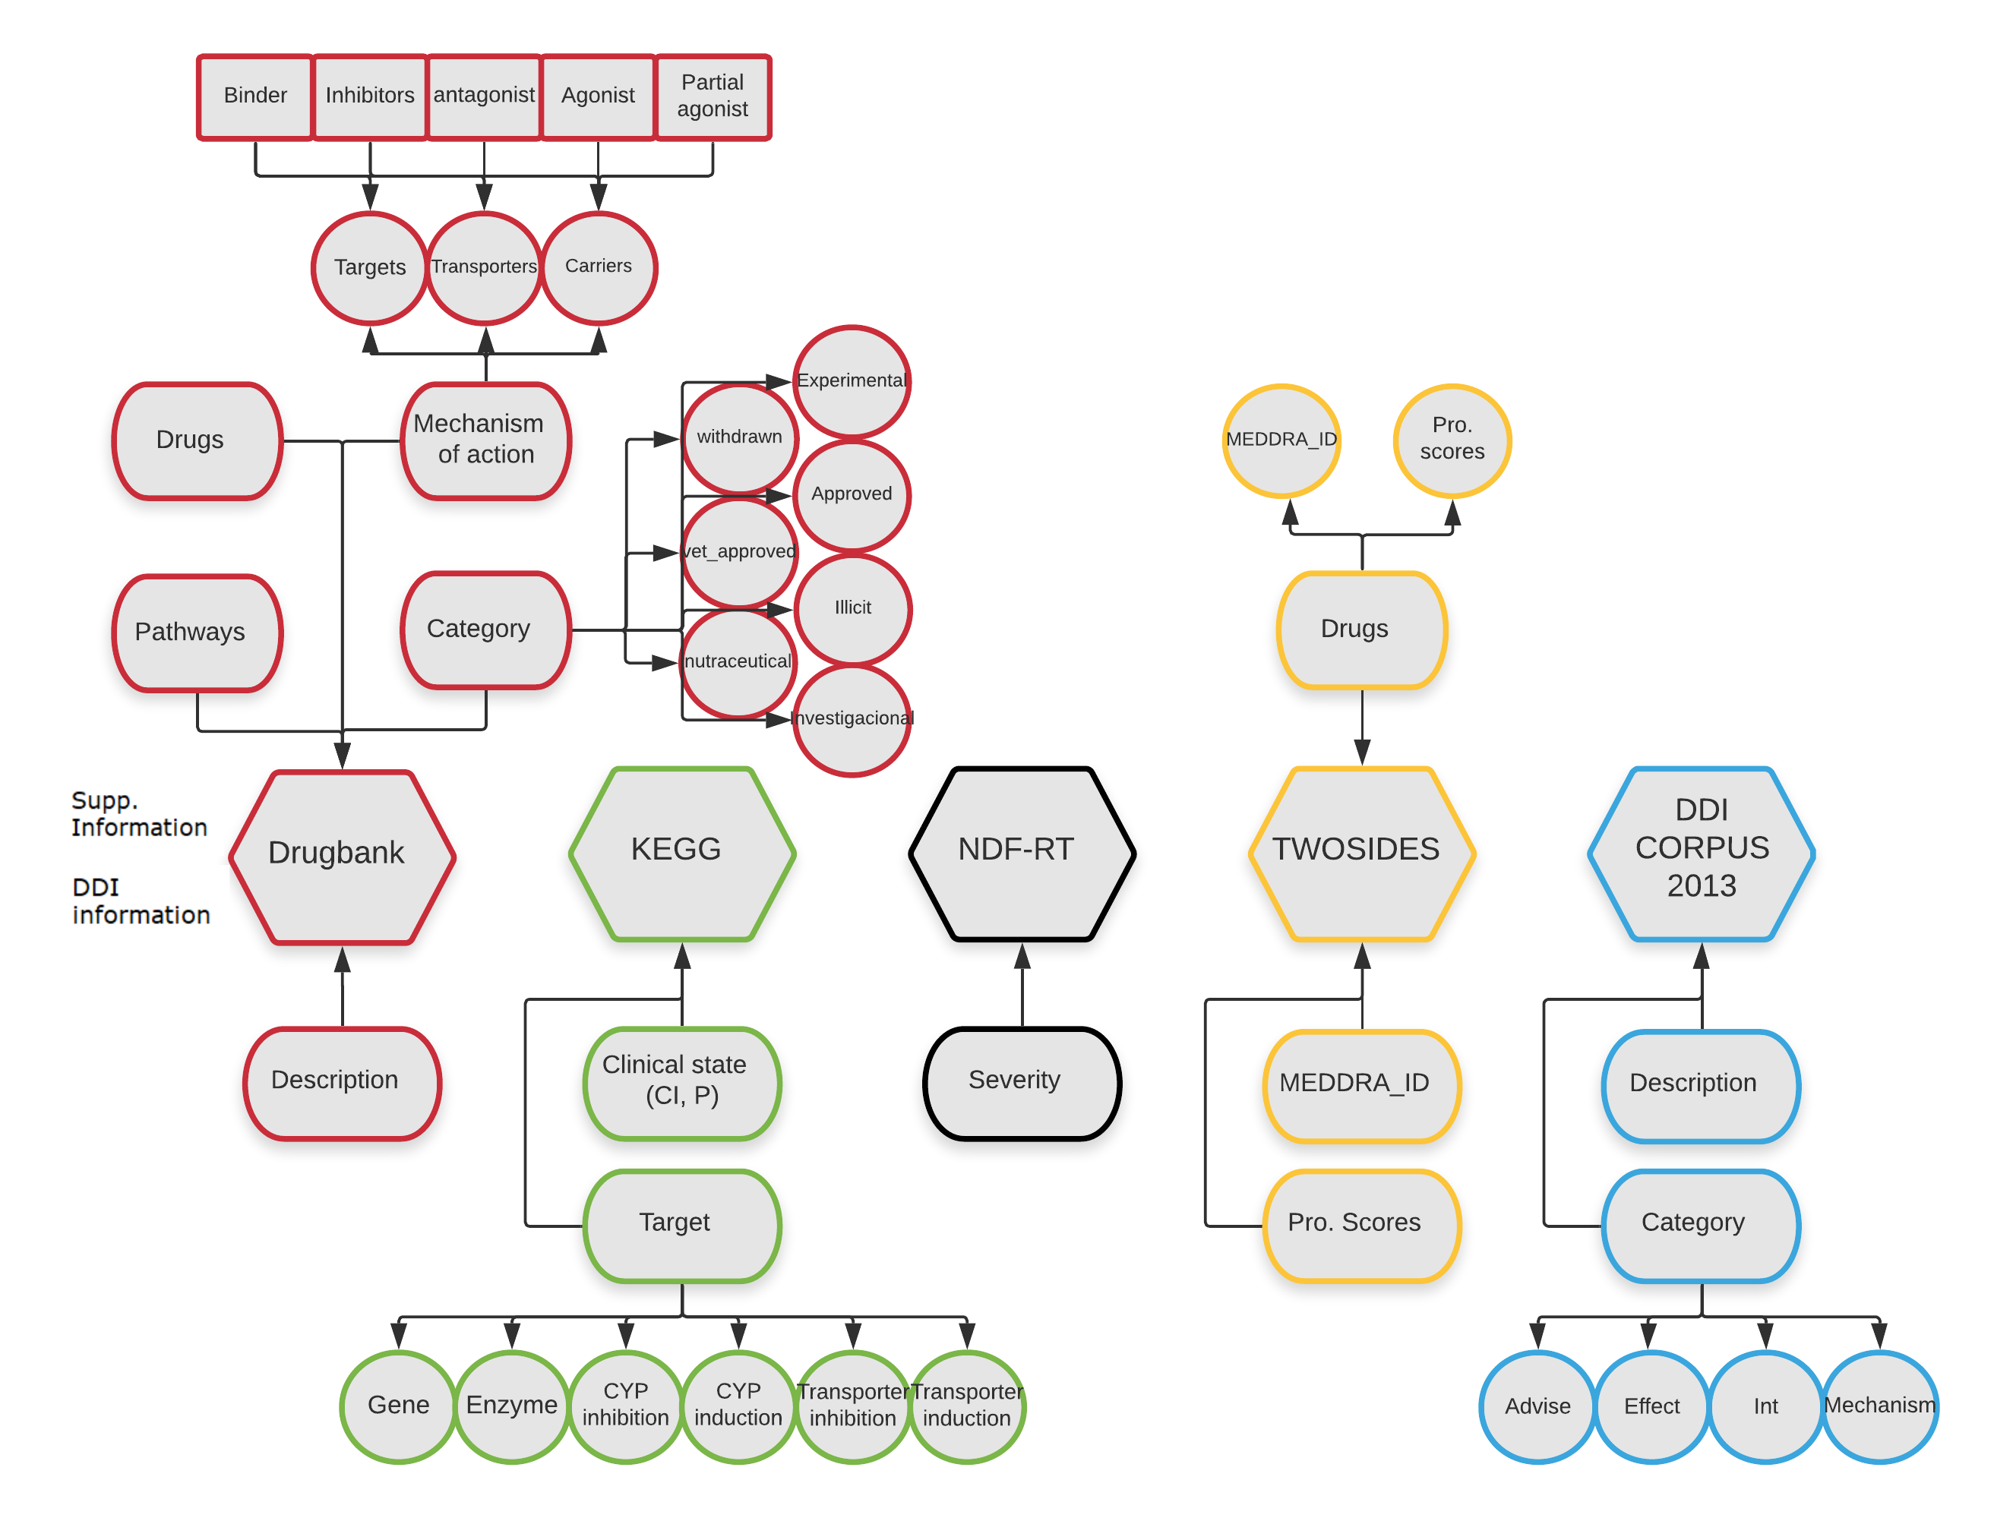
DATA EXTRACTED
Restrictions
Each drug must have a Drugbank identifier
Each drug must have an ATC code

Slide 6
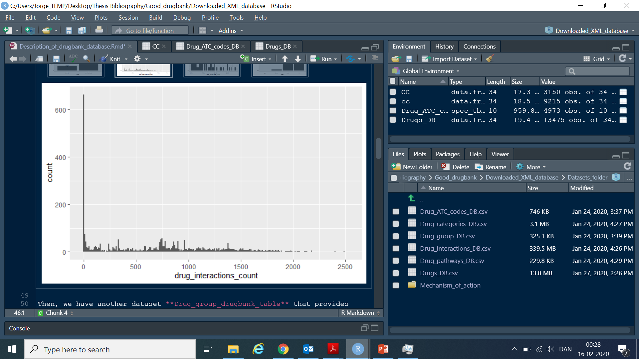
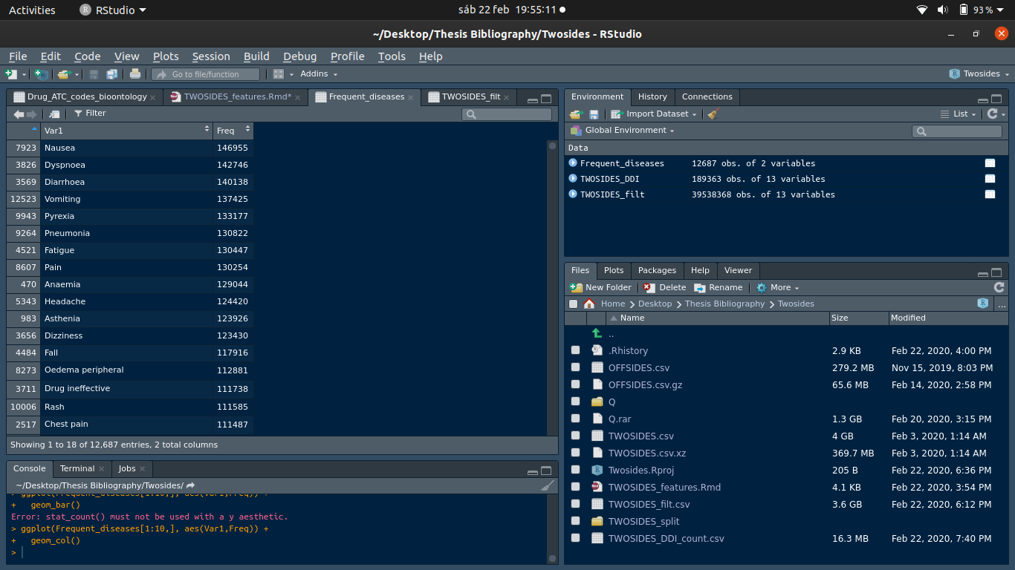
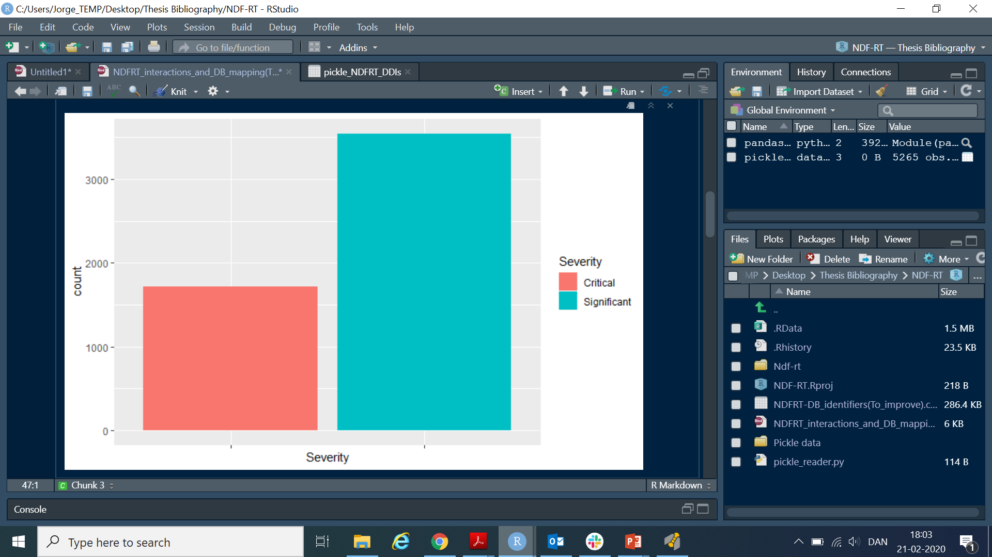
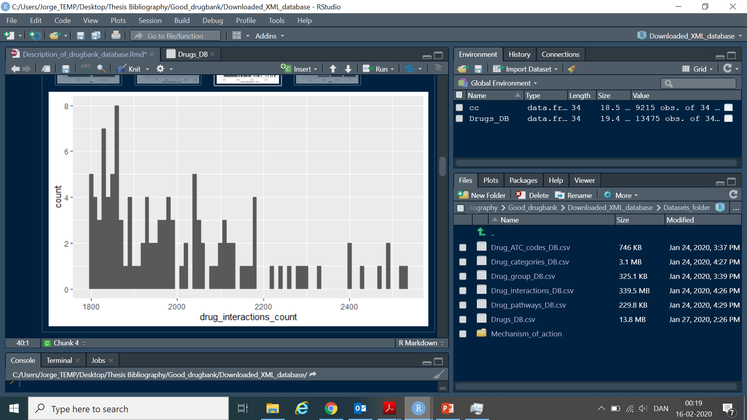
SOME STATISTICS
DRUGBANK:
4264 drugs
2093179 interactions
NDF-RT:
1206 drugs
4354 interactions
TWOSIDES:
1484 drugs
189363 interactions
12726 side effects

Slide 7
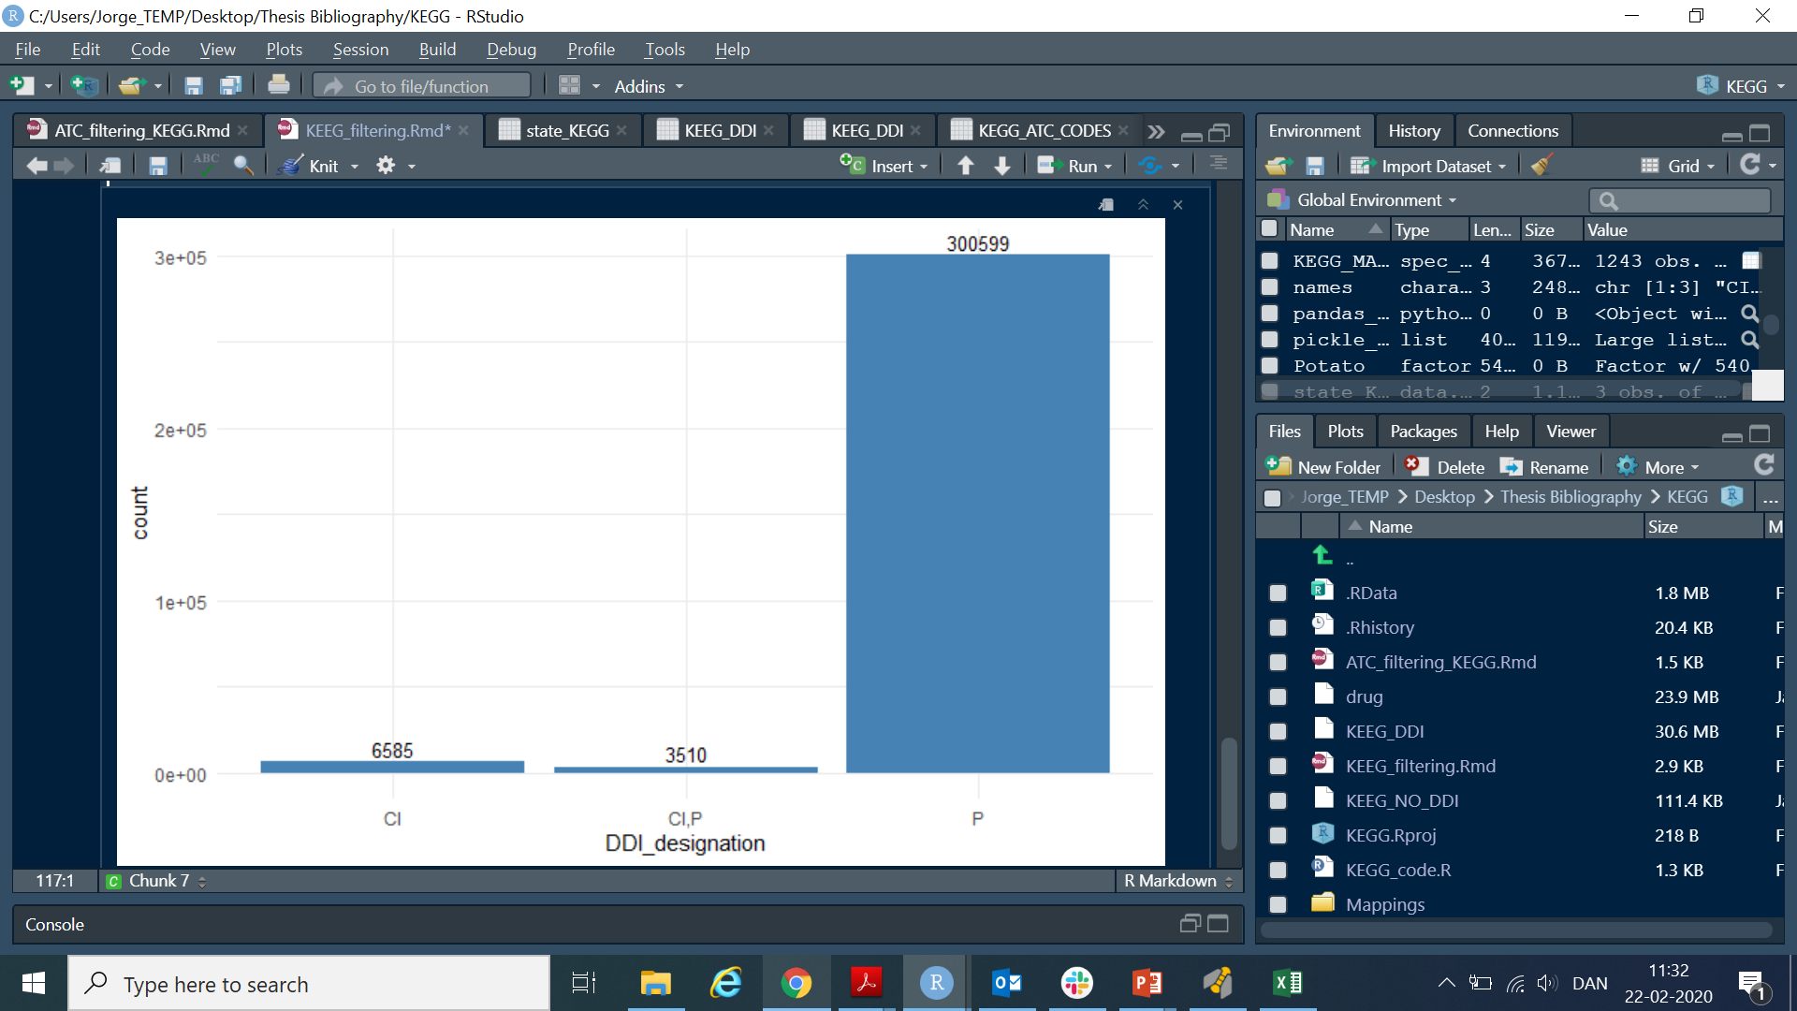
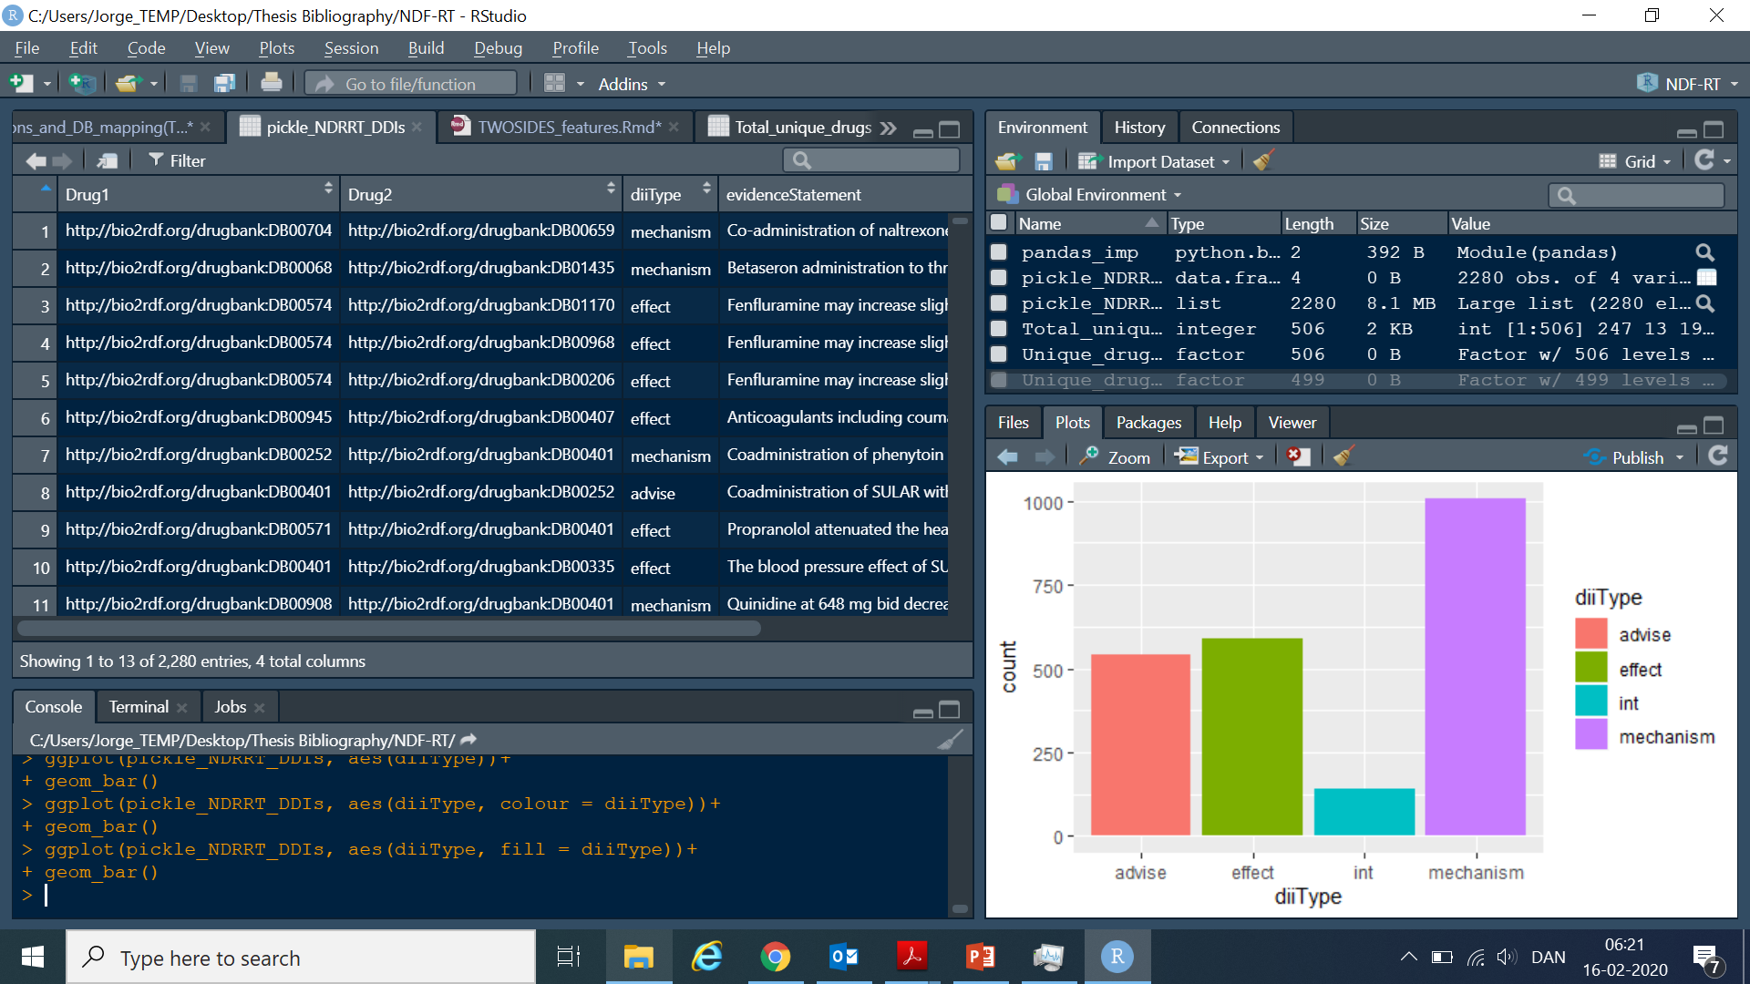
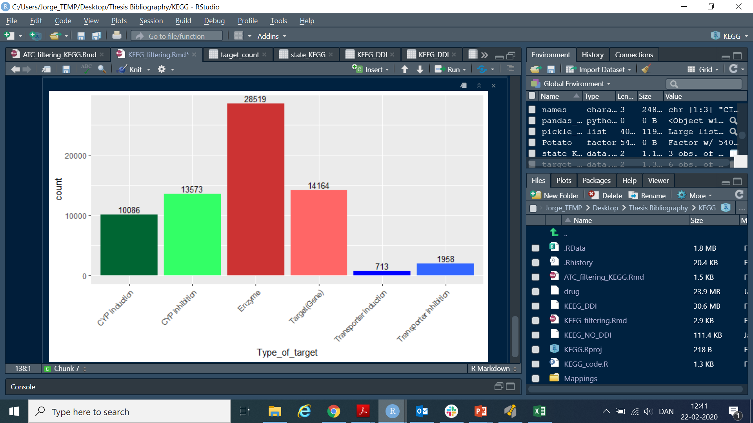
KEGG:
2859 drugs
310897 interactions
85% unknown action
DDI CORPUS 2013:
649 drugs
2160 interactions

Slide 8
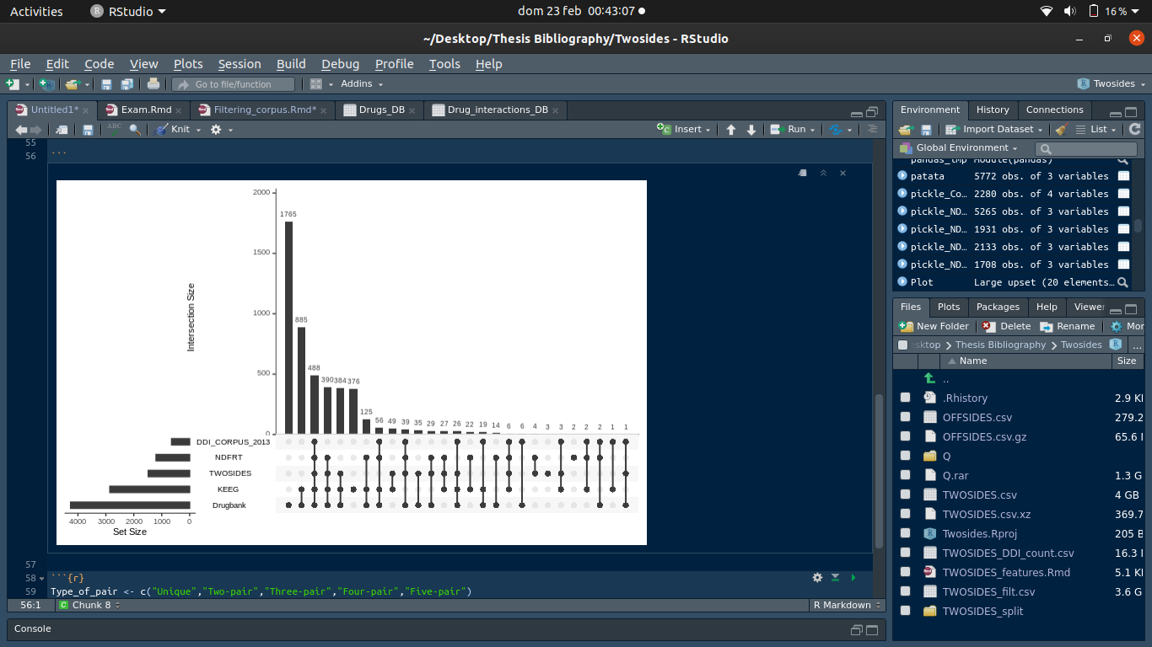
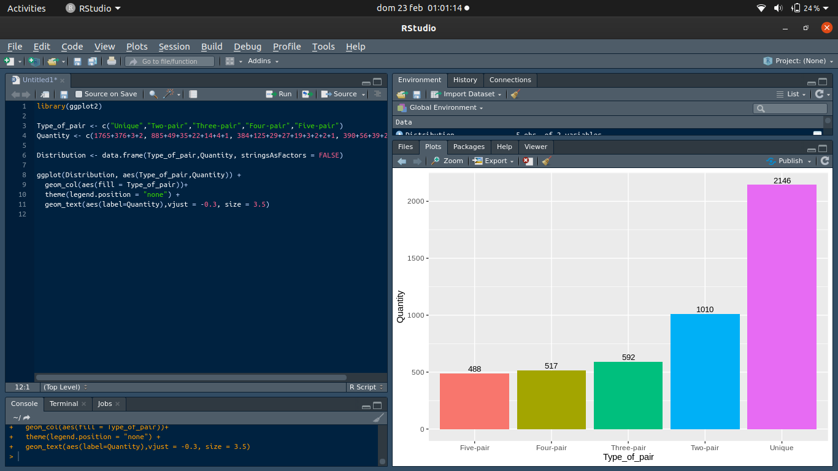

Slide 9
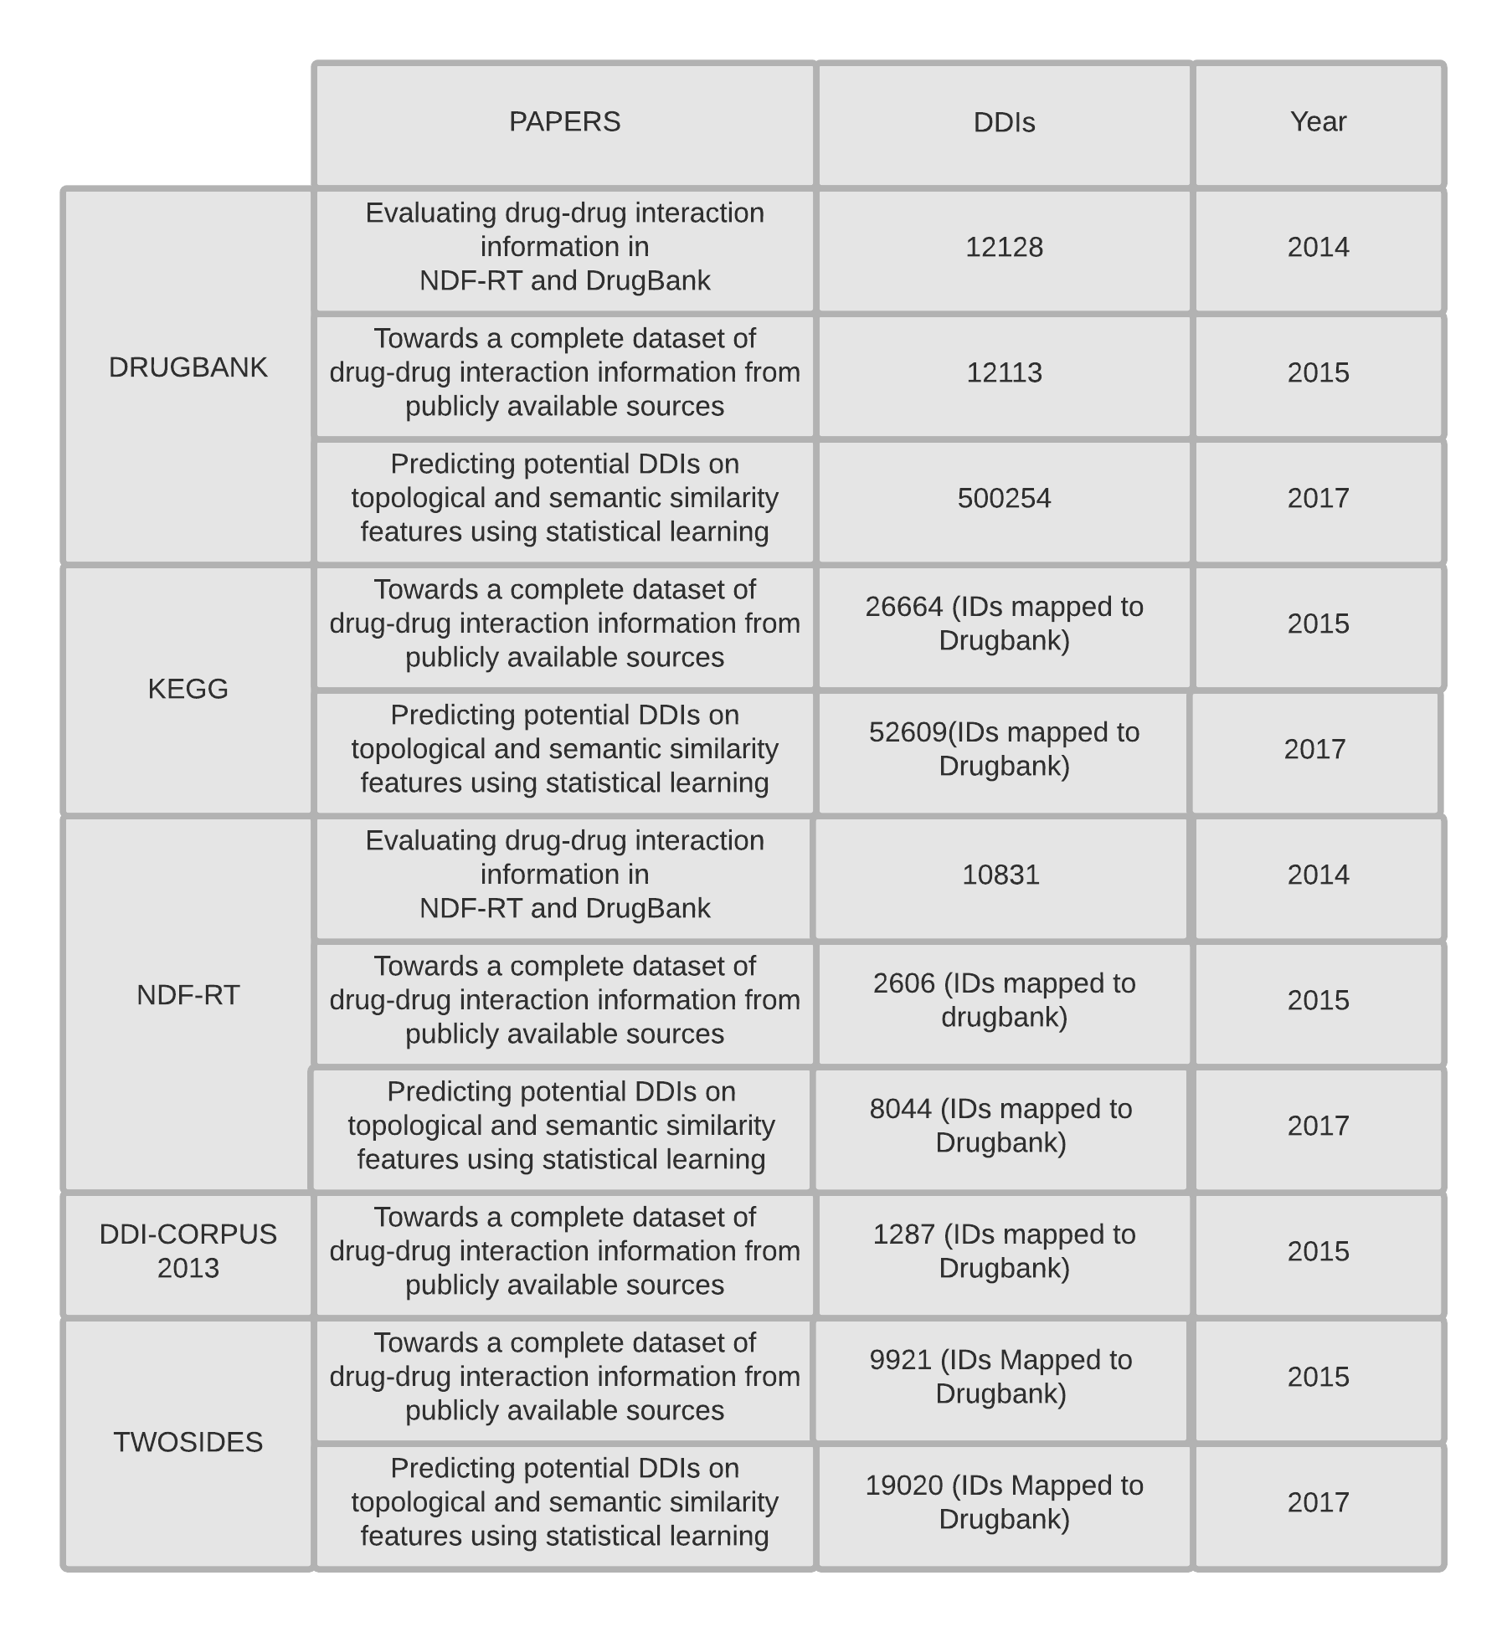
REFERENCES

